Slide 1

IS4301 Agile IT with DevOps
Tutorial 6

Slide 2
Hands-On Tutorials Series
Objective: Build a simple “Hello World” application
Application functionality: User authentication with Firebase
Technology Stack:
Client side: React.js
Server side: Firebase
Version Control: Git
Screenshot your progress and submit a report to Luminus

Slide 3
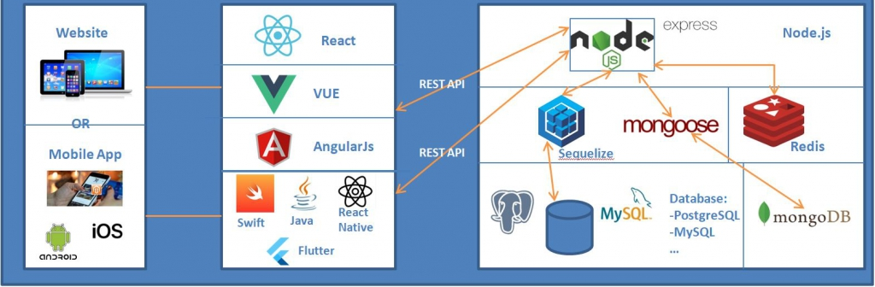
Three levels: can be developed independently
Client Side
Server Side

Slide 4
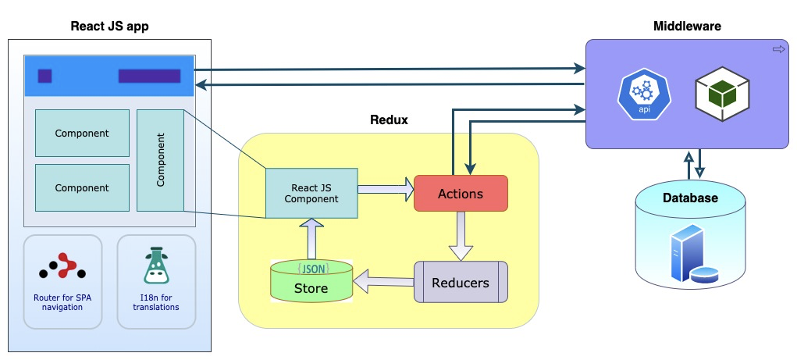
React JS Architecture: Smaller Independent Components

Slide 5
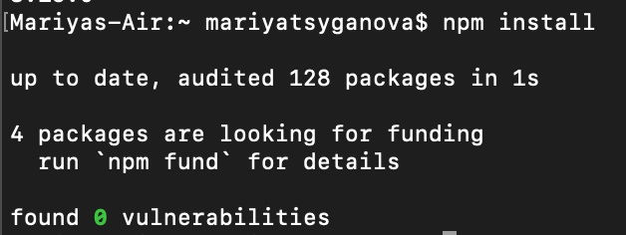
Tool Preparation
Install
Node.js
https://nodejs.org/en/download/
Sublime text editor
https://www.sublimetext.com/
Open Command Prompt/Terminal/Console
Run a command: npm install
Check the version of npm and node:
npm –v
node -v

Slide 6
Command line navigation
List files in the directory: ls
Navigate to the root folder: cd
Navigate to one of the folders: cd <folder name>

Slide 7
Task 1: Create and run your React App
Navigate to a working directory
Create application:
npx create-react-app <appname>
Navigate to <appname> folder
Run your application:
npm run
Terminate your application

Slide 8
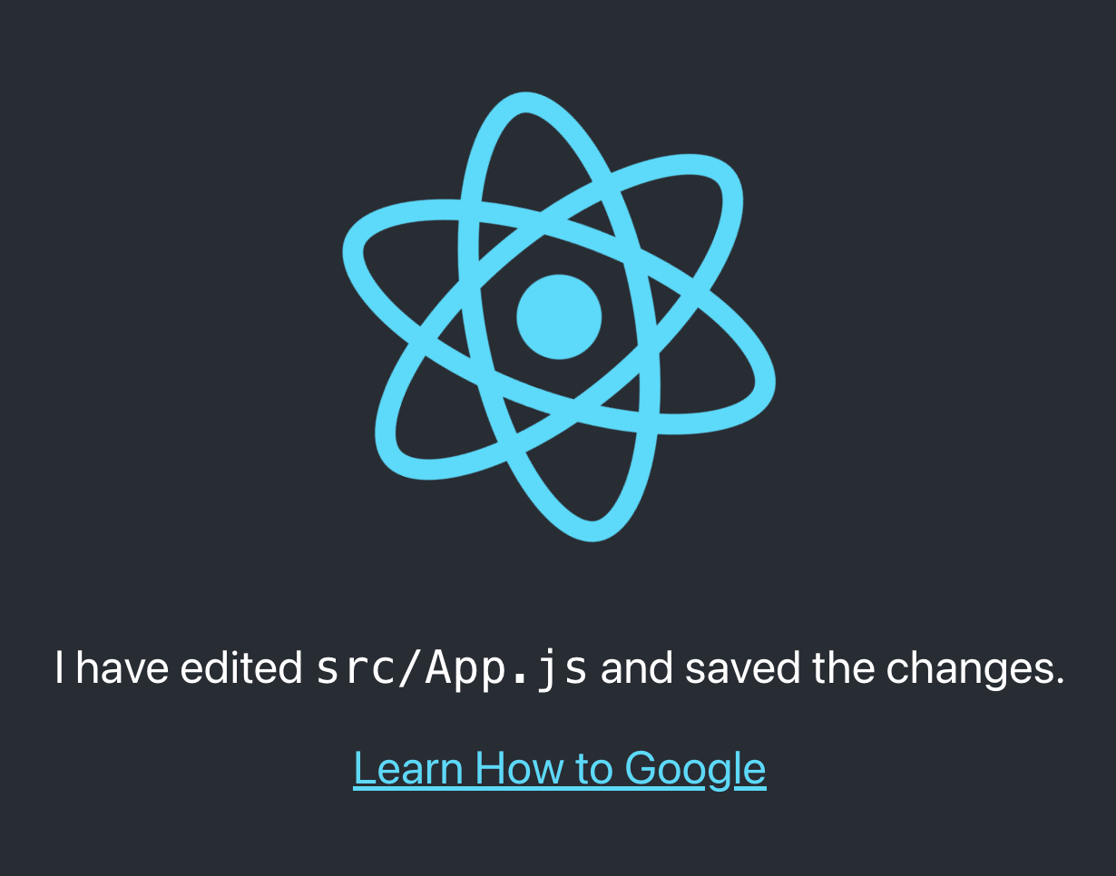
Task 2: Change App.js to produce the screen

Slide 9
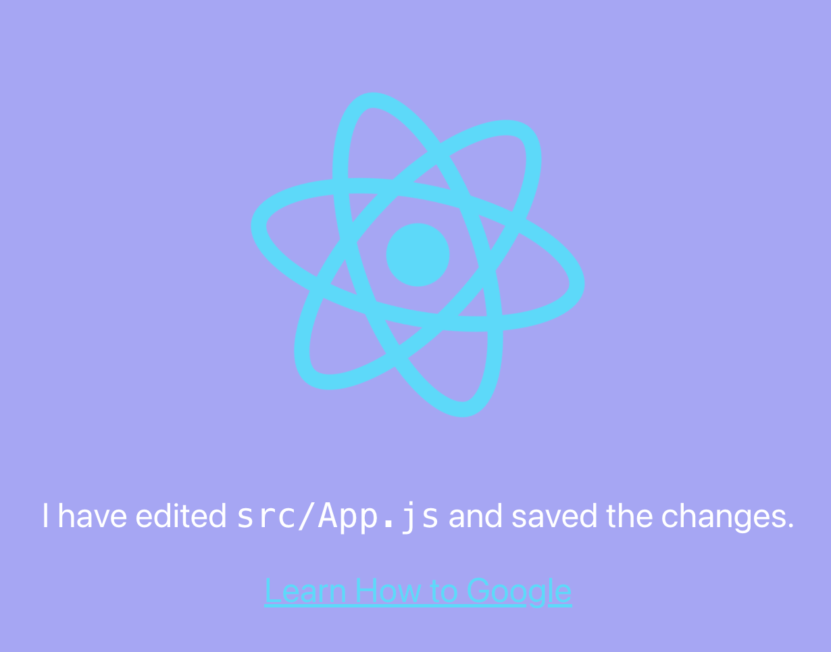
Task 3: Change App.css to produce a similar screen

Slide 10
Task 3: Make any design changes of your choice in the project
Things you can change:
Fonts (e.g. size, family)
Colors of the elements
Logo icon
Logo spinning speed
Margins between the elements (explore other css files)
Text

Slide 11
Key Takeaway
Component/Service-based architecture enables scalability
Component/Service-based architecture allows independent development
Component/Service-based architecture enables agile development

Slide 12
Submit your report to Luminus

